Slide 1
Define the Modern Specs for Prototype Development
Module 3
Notes:
Module 3: Define the Modern Specs for Prototype Development

Slide 2

Class Expectations
Cameras On
Be present and visible with your camera on to stay engaged in class.
Arrive On Time
Respect everyone’s time by arriving promptly to sessions.
Active Engagement
During exercises and labs, participate actively in all discussions and activities.
📹
⏰
✋
Network
During class, connect with peers and build your learning network.
Use Slack
Use Slack for all communication to keep questions and comments organized.
Instructor Support
Save deeper questions for after class with your instructor so as to not stop class flow.
🌐
🎓
Notes:
Notes
📌Note for instructors: Please do not share the link to the slide deck with students. If they want to view the deck, send them to the LMS where they can view it from there.
Where to access content? You can view the deck from Docebo.
ℹ️ All students should have access to the LMS (Docebo) with all the class materials by now. If not, please reach out to Student Success directly in Slack.

Slide 3
AI Prototyping Certification Syllabus
Accelerate the Idea-to-Validation Cycle
Shift from static specs to interactive prototypes that win alignment fast. Learn why AI prototyping is a critical PM skill reshaping the role, and experience firsthand how to turn ideas into prototypes in minutes.
Write Advanced Prompts for High-Fidelity Prototypes
Master prompting as a core execution skill for the modern PM. Move beyond simple commands to learn the advanced, structured techniques that generate functional, high-fidelity results.
Define the Modern Specs for Prototype Development
Master the new approach to requirements with the one-page prototype spec. Learn to transform your prototype into a clear, actionable document that drives team alignment and accelerates development.
MODULE 1
MODULE 2
MODULE 3
Build, Iterate, and Debug Prototypes End-to-End
Translate specs into working prototypes and test in real time. Use AI as a co-pilot to debug quickly, reduce risks, and ensure your builds are resilient, scalable, and ready to evolve.
Power Advanced Prototypes With API Integrations
Take your prototype to the next level by incorporating advanced, secure integrations. Learn the workflow design for connecting to live APIs while ensuring compliance, scalability, and stability.
Deploy and Scale Prototypes Into Production
Master the fastest path from a working prototype to production. Learn to manage the final deployment and handoff, leveraging rapid iteration to save significant engineering time and cost.
MODULE 4
MODULE 5
MODULE 6
Notes:
AI Prototyping Certification Syllabus
Build, test, and ship interactive AI prototypes that turn ideas into working products in record time.

Slide 4
Agenda
01 Why Specs Must Evolve in the AI Era
02 The Simplified PRD for Prototypes
03 Hands-On Lab: From Requirements to Prompt Pack
04 AI Workflows For Requirements Refinement
Notes:
Agenda
Why Specs Must Evolve in the AI Era
The Simplified PRD for Prototypes
Hands-On Lab: From Requirements to Prompt Pack
AI Workflows For Requirements Refinement

Slide 5
Why Specs Must Evolve in the AI Era
Notes:
01. Why Specs Must Evolve in the AI Era

Slide 6

Instructor-Led Q&A
Questions
Have you ever spent time and effort building a PRD that was already outdated by the time it reached engineering?
If yes, what aspects of the PRD were hardest to keep aligned with the evolving product or team priorities?
Your Experience With PRDs
Q&A DISCUSSION
5 minutes
Feel free to post your answers in the chat or unmute and share!
To get you thinking, opening up and sharing your personal experience and knowledge with traditional Product Requirements Document (PRD) development, discuss the following questions.
Notes:
Notes
💥Activity: Instructor-Led Q&A
💬Topic: PRD Development Experience
⏱️Time: 5 Minutes
Note for instructors: Feel free to open up the room by sharing your own personal experience with traditional PRDs first. Students love to hear your storytelling and moments of both success and failure.
To get you thinking, opening up and sharing your personal experience and knowledge with traditional PRD development, discuss the questions on the slide.
Questions:
Have you ever spent time and effort building a PRD that was already outdated by the time it reached engineering?
If yes, what aspects of the PRD were hardest to keep aligned with the evolving product or team priorities?

Slide 7

Before You Build A Full PRD
Simplified PRD
What is it?
💡
A concise, one-page document outlining the core features and functionality of an AI-generated prototype.
What is its value?
🌟
It ensures alignment with stakeholders, focuses on user needs, and provides a foundation for quick feedback and iterative development.
As AI accelerates prototyping, product specs must evolve. The simplified PRD helps PMs capture the essence of a product idea — not in 20 pages, but one, structured for AI collaboration.
When is it needed?
🗓️
It is used after ideation to refine and align the prototype before full-scale development begins.
What is the PM’s role?
🤝
As a PM, you define product functionality and work with AI through a critical product lens, ensuring the output aligns with user needs and business goals.
Notes:
Notes
If you’ve shared that you have run into the challenge of PRDs being outdated or too slow to keep up with evolving product ideas, that’s exactly the problem Simplified PRDs are designed to solve!
Keynote: A s Simplified PRD is one that, in the prototyping era, is re-imagined for speed. It’s not about every feature, every corner case, or long timelines. It’s about the core functionality you need to validate quickly with AI. Concise, modular, action-oriented, AI-first. That’s its DNA.
Analogy: If a PRD is a 30-page novel, this is a 1-page screenplay enough to get a pilot episode built and tested.
Deep Dive:
What It Is: A Simplified PRD is a concise, one-page document that outlines the core features and functionality of your AI-generated prototype.
It serves as a guide for the prototype’s vision by focusing on the what and why behind the product’s core functionality, without diving into deep technical specs.
Why It’s Valuable: This type of PRD is essential for alignment among stakeholders and the product team.
It provides clarity on user needs and ensures that the AI-generated prototype is in line with the product’s goals. This clarity helps move faster by focusing on the key features that need to be developed.
When It’s Needed: This PRD is used during ideation, to help build out the prototype and validate the idea, before full-scale development begins.
It’s used to ensure things are heading in the right direction, providing a clear blueprint for the next steps.
PM’s Role: As a PM, you define the product functionality and work with AI through a critical product lens.
This means evaluating and validating the AI-generated prototype to ensure it aligns with user needs and business goals, using your critical thinking and product principles to refine the output and guide development.

Slide 8

Simplified PRDs Get Rapid Validation
The New Development Cycle
YOU ARE HERE
The Blueprint Phase: You are here to translate vague ideas into the structured logic (FUDI) needed to drive the AI validation loop.
Prompt, test the build, and update the Simplified PRD.
You have a hypothesis for a feature or product.
Draft the core prototype constraints (FUDI).
Visualize the requirements instantly.
Once validated, freeze requirements into formal PRD and user stories.
Real product is coded using validated prototype for reference.
Idea
Rapid Validation Loop
Stabilization
Execution
Simplified PRD
AI Prototyping
Notes:
Notes
One of the best questions you might ask is: "How is this 'Simplified PRD' different from the massive PRD I usually write?"
As we mentioned in Module 1, you can go from Prompt to Prototype within hours. In the old world, the PRD was a wall. You wrote it, handed it off, and hoped Engineering understood it.
In the new world, there’s a quick validation loop in the middle. This is where you are today.
Idea: You start with a concept.
Simplified PRD (You Are Here): You don't write a novel. You write a "Blueprint"—just enough FUDI constraints to prompt the AI.
AI Prototype: You build it instantly.
The Update: You see the prototype, realize the flow is wrong, and update the Simplified PRD immediately.
By the time you get to Step 3 (Stabilization), you aren't guessing. You are writing user stories for a product you have already built, tested, and validated. The PRD becomes a record of truth, not a record of guesses.

Slide 9
Spec Showdown
Speed vs. Stability
Your prototype spec acts as your draft for your traditional PRD; validated so you don’t have to re-write it 5 times.
 | The “What” THE PROTOTYPE SPEC(Simplified PRD) | The “How” THE ENGINEERING SPEC(Traditional PRD)
GOAL | Validation; Prove the idea is worth building. | Execution; Build the idea correctly at scale.
AUDIENCE | Design, Product, Leadership. | Engineers, QA, Data Science, Legal
FIDELITY | “Happy Path” Focus; Covers core flow and main use case. | “Edge Case” Focus; Covers errors, detailed security, load states, and tracking.
LIFESPAN | Disposable; Rapidly updated based on prototype feedback. | Permanent; The “system of record” for the build.
FORMAT | FUDI Framework; concise, constraint-based prompting. | Detailed Documentation; User stories, acceptance criteria, technical specs.
Notes:
Notes
Don't confuse the map with the territory. Use a Simplified PRD to find the right path, and the traditional PRD to pave it for the heavy machinery.
A simplified PRD isn’t replacing your traditional PRD. Think of it more as your first draft that you validate, so you don’t need to rewrite your detailed PRD 5 times.
Simplified PRD (The “What”): This is your "Speedboat." It’s light, fast, and aimed at the AI.
Its job is to get a visual validation.
focuses on the Happy Path—what happens when everything goes right.
If the user hates it, you throw it away. No harm done.
Traditional PRD (The “How”): This is your "Cargo Ship." It carries the heavy load for Engineering.
Its job is to handle Scale.
It focuses on the Edge Cases—what happens when the API fails? What about security? What about accessibility compliance?
You don't write this document until the Simplified PRD has proven the idea is a winner.
Don't look at them as competitors. The first is the feeder for the PRD. You use the it to get the "Yes." Then you use the PRD to get the "Done."

Slide 10
The Simplified PRD for Prototypes
Notes:
02. The Simplified PRD for Prototypes

Slide 11

Value for Product Managers
Vague ideas and prompts lead to weak, unusable prototypes. The Simplified PRD acts as the translation layer, converting your abstract product vision into a prompt blueprint the AI can execute perfectly. It forces structure by applying FUDI constraints, creating consistency and repeatable processes so you can answer:
How can I validate my idea and get user feedback before I consume engineering resources?
Your Vision (Abstract) + Simplified PRD (Structured Logic) = Executable Prototype (Validated)
Notes:
Notes
So why is a simplified PRD is so valuable for you as a Product Manager? In Module 2, you've seen that vague ideas or simple prompts lead to weak, prototypes. This is the solution to that problem.
It Forces Structured Product Thinking: This document is the practical application of the FUDI framework. It forces you to put your "Product Hat" on before you start prompting. By defining the Inputs, Flow, and Constraints upfront, you translate your abstract vision into logic that the AI can actually understand.
It Creates a "Prompt Blueprint": Think of it as an instruction manual for the model. Without it, the AI has to guess your intent. With it, the AI simply executes your requirements. It serves as a "Source of Truth" that keeps the prototype consistent, even as you iterate through 50 versions
It De-Risks Ideas: Ultimately, it answers one of the key question of product management: “How do I validate my idea before I consume engineering resources?”
This is the real power of the simplified PRD combined with AI prototyping. It allows you to build a high-fidelity, testable prototype in hours or days—not weeks or months. You can get real user feedback and validate your core assumptions before you ever write a single line of production code or consume expensive engineering sprints. It’s a tool for massive de-risking and acceleration.

Slide 12
The Seven Building Blocks of a Simplified PRD
🔎 Project Overview: Defines the use case (core problem), the goal (measurable outcome), and the target user (persona) for the prototype
🔃 Inputs and Outputs: A structured table defining the data flow, mapping specific inputs (what enters the system) to expected outputs (what the system delivers).
➡️ Ideal User Flow: Sequence of 3-5 bullet steps outlining the ideal user journey, showing the path from entry to the desired outcome.
🛠️ Core Tools and Stack: A list of the tools, APIs, platforms, or libraries required to build the product.
🧠 Smart Behaviors: The decision logic and conditional rules ("If X, then Y") that guide how the system responds to specific user actions.
🚧 Constraints and Edge Cases: Identification of technical boundaries, limitations, or error states the system must account for to prevent failure
📝Light Eval: A small test set for the pilot plan with defined success criteria (e.g., <1s latency, 90% usability score etc.)
Use our template and create your own Simplified PRD 🔗here
✍️
Notes:
Notes
👉 Share the template with students here
So, what goes into this document? Remember, you aren't writing for a committee; you are writing for a code generator. Each section needs to be clear enough to be pasted into an AI chat window.
Project Overview: This acts as your System Prompt. It sets the context. Tell the AI who is using the tool and what problem they are solving..
Inputs & Outputs: This is your data contract. The AI needs to know exactly what enters the system (e.g., "CSV File") and what leaves it (e.g., "Bar Chart"). If you are vague here, the logic will break.
User Flow: Keep this strictly to the "Happy Path." What are the 3-5 steps a user takes to succeed? Don't worry about complex error paths yet; just get the core flow workin
Core Tools & Stack: This is the Technical Context. Are we building in React? Vue? HTML? Do we need Tailwind CSS? Defining this upfront stops the AI from using random, outdated libraries.
Smart Behaviors: This is the "Brain" of the prototype. This is where you define the logic: "If the user clicks this, calculate that." This turns a static picture into a functioning product.
Constraints & Edge Cases: This is your hallucination prevention. Explicitly tell the AI what not to do (e.g., "No infinite scroll," "Mobile-only")
Light Eval: How do you know it works? Don't just say "Make it fast." Give it a number. "Latency under 1 second." "90% accuracy." This gives you a clear Pass/Fail metric for the pilot.

Slide 13
Mapping Your Requirements with FUDI
PRD Building Block | Primary FUDI Element | What to Capture
 |  | The Goal & The Vibe: Define the core function (F) and the target persona/style (D).
 |  | The Data Contract: What data enters and what leaves.
 |  | The Happy Path: The sequential, logical steps the user takes from A to B.
 |  | The Tech Context: The specific frameworks (React) or APIs that enable the functionality.
 |  | The Brain: The logic (F) and how the system responds (I) to user actions.
 |  | The Guardrails: Technical limits (F) and error handling for unexpected interactions (I).
 |  | The Success Metrics: Measuring if it works (F), looks right (D), and feels right (I).
Project Overview
F
D
Inputs & Outputs
F
User Flow
U
Core Tools & Stack
F
Smart Behaviors
I
F
Constraints & Edge Cases
I
F
Light Eval
F
D
I
F Functionality
U User Flow
D Design
I Interaction
Notes:
Notes
How do the 7 Building Blocks ensure a perfect prompt? They force you to define every element of FUDI without even thinking about it. It’s not a question of one or the other: your simplified PRD is the container for FUDI.
Think of it like this: If you try to write a prompt from scratch using just FUDI, you might miss things. But if you fill out these 7 Building Blocks, you automatically capture the Functionality, User Flow, Design, and Interaction.
The goal is to help you think like a translator and turn written requirements into modular, FUDI-based prompts that guide the AI to build the right functionality, flow, and design with precision.
This means looking out for:
Project Overview (F, D): State what the product is, who it’s for, and the look/feel so the AI has intent and visual direction. In the Prompt Pack, this becomes a short setup prompt that names the app, audience, and design cues—so every later prompt inherits the same purpose and style.
Inputs & Outputs (F): Spell out exactly what comes in (files, fields, APIs) and what must come out (lists, cards, messages). In the Prompt Pack, write a prompt that binds UI to these I/O contracts (e.g., “after upload, show X; render Y fields from mocked data”).
User Flow (U): Convert the journey into 3–7 numbered steps so the build follows a predictable sequence. In the Prompt Pack, one prompt declares screens/states in order (Home → Upload → Results), which prevents the tool from skipping key moments.
Core Tools & Stack (F): Name frameworks, libraries, and any AI/model assumptions to anchor feasibility. In the Prompt Pack, add a brief constraint line (“React + Tailwind; simulated AI; no backend”) so the tool scopes itself correctly.
Smart Behaviors (I, F): Describe how the system “thinks” and responds (ranking, rules, prioritization). In the Prompt Pack, include a behavior prompt that tells the tool how to transform input into output (e.g., “use mocked JSON; adapt copy/images to match context; prioritize relevance”).
Constraints & Edge Cases (F & I): Define guardrails and graceful failures (blurry input, empty results, privacy). In the Prompt Pack, add a robustness prompt that instructs empty states, error toasts, and safe defaults so the prototype doesn’t break.
Light Eval (F & D & I): Set success criteria (latency targets, clarity/usability goals, acceptance checklist). In the Prompt Pack, include a polish prompt (“aim for <1s perceived feedback; ARIA labels; accessible contrast; concise copy”) so the tool optimizes for testability, not just looks.

Slide 14
The Rapid Validation Loop
Define the core user problem and hypothesis.
Fill out the seven building blocks to capture the FUDI constraints.
From Static Document to Executable Code
This 4-step cycle turns raw ideas into validated prototypes in hours. The core mechanic is transforming your static Simplified PRD into a sequential "Prompt Pack"—a modular chain of instructions that guides the AI to build complex features without losing fidelity.
1. Develop an Idea
2. Draft Your Require-ments
4. Prototype & Iterate
3. Sequence the Prompt Pack
Run the prompt packs, test the build, and update the PRD based on findings.
Break the PRD blocks into an ordered list of prompts for accuracy: Context → Structure → Logic,
Notes:
Notes
Earlier we mentioned the "Rapid Validation Loop” in this new development cycle. Now, let’s look at exactly how you execute it.
Step 1: Develop an Idea. Start with the problem and the hypothesis you aim to test. Who loses time or money if this doesn't exist?
Step 2: Draft the Simplified PRD as your source of truth. You fill out the template we just discussed. This captures all your FUDI constraints in one place.
Keep in mind: This document is your Master Record, but you don't dump the whole thing into the AI at once. That overwhelms the model.
Step 3: Sequence the "Prompt Pack" for your execution strategy. This is the "Translator" step. You break your PRD into a sequence of copy-paste blocks. Why do this? Because AI builds better when you give it Chain-of-Thought instructions. The "Prompt Pack" is just your Simplified PRD, sliced into digestible bites.
Prompt 1 (Setup): You paste the Project Overview and Tools.
Prompt 2 (Structure): You paste the User Flow and Inputs/Outputs.
Prompt 3 (Logic): You paste the Smart Behaviors.
Step 4: Prototype & Iterate. You run the pack. You see the result. If the logic is wrong, you don't just hack the chat; you go back to Step 2, update the PRO, and re-run. This keeps your documentation alive

Slide 15
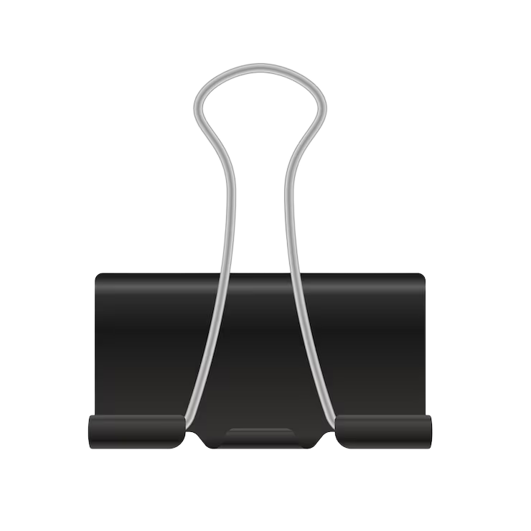
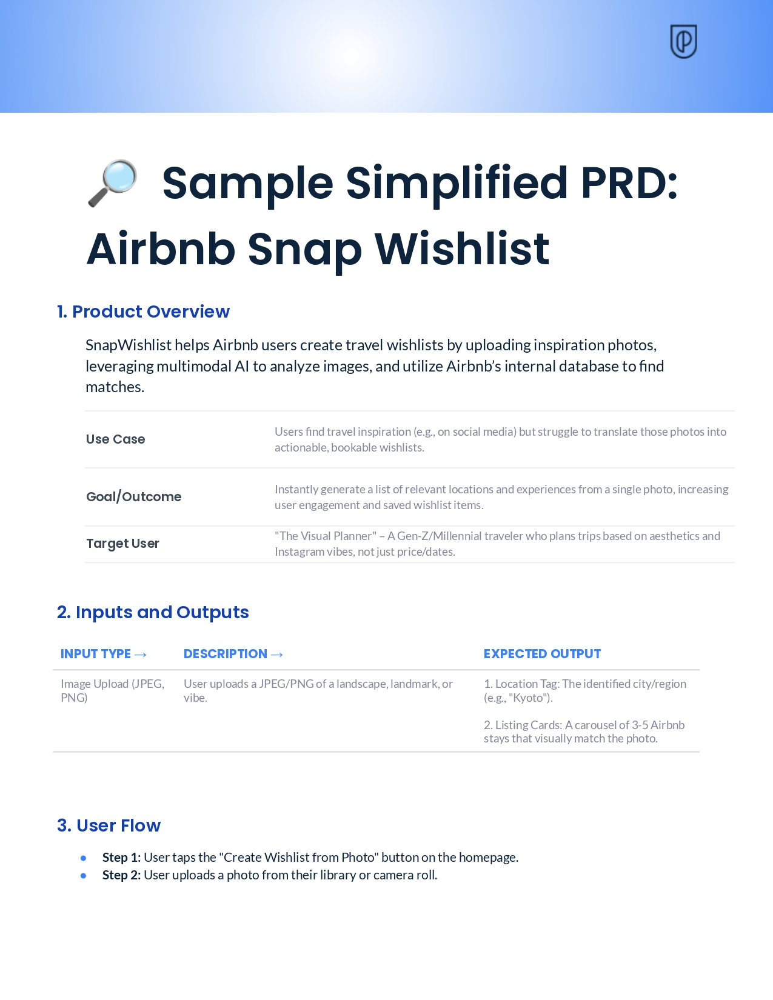
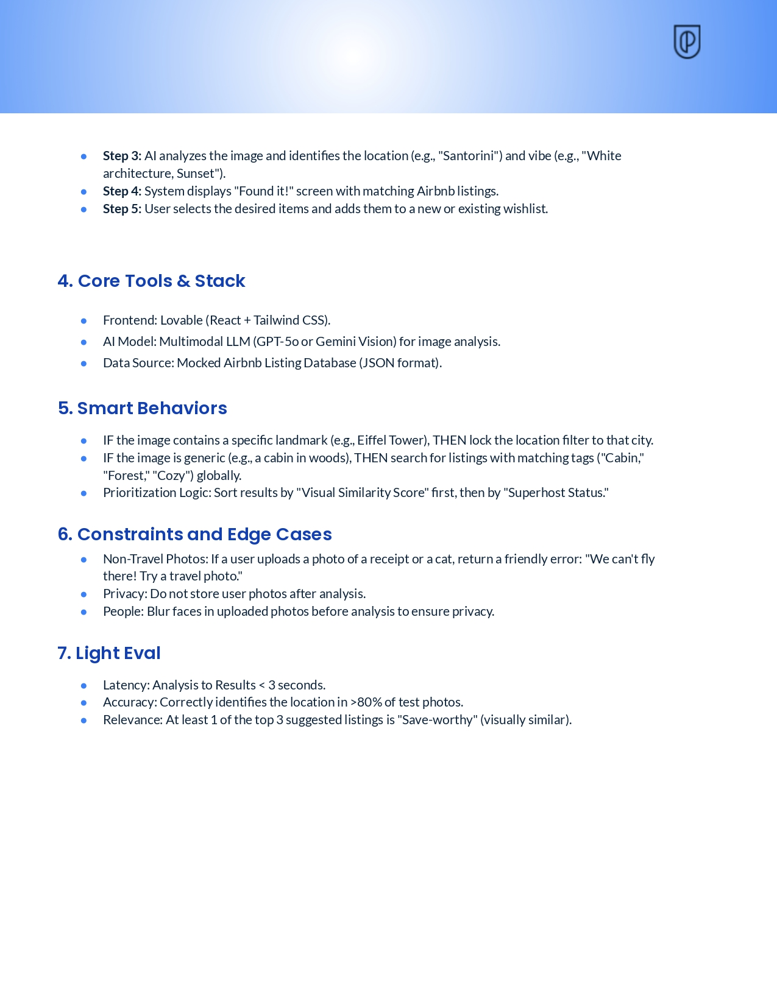
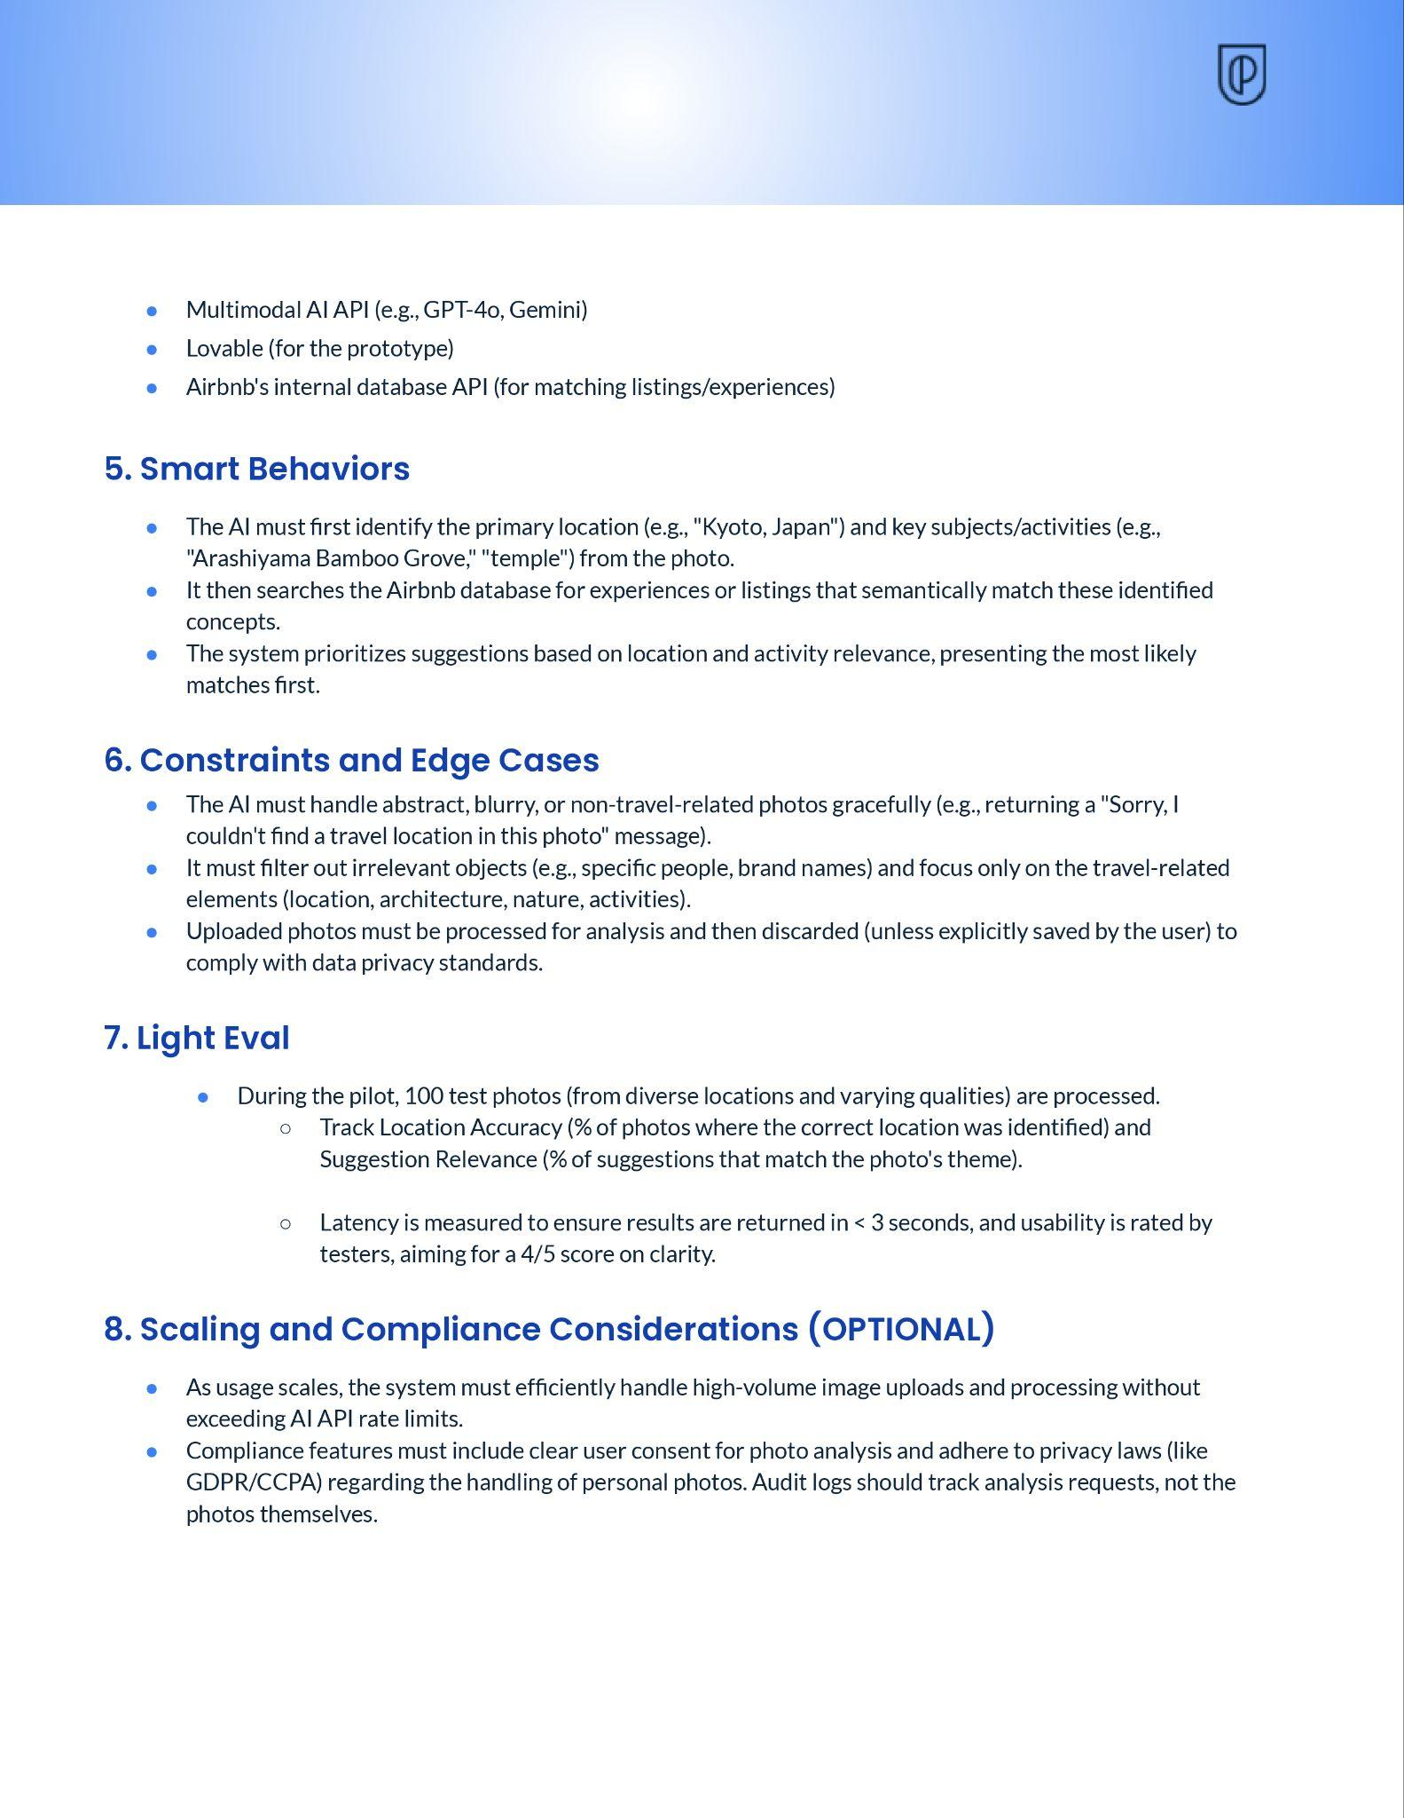
Example Snapshot
Simplified PRD Sample
🔎
See the example in full screen here
Notes:
Notes
📌 Note for instructors: Pause here and walk students through what this might look like to make the concept more tangible.
Share the full screen version here: EXAMPLE: Airbnb Snap Wishlist
Ask students some key questions about sections of the Simplified PRD to get them thinking critically about the value of completing each section.
Example questions:
(Design) Look at the 'Target User' section. We wrote 'Visual Planner.' If you changed that to 'Budget Backpacker,' what do you think would happen to the UI?
Possible Answer: The AI might strip out the big photos and replace them with price tags and discount badges. One word could change the whole vibe.
(Functionality/Interaction): Look at the Smart Behaviors. We told it to 'Prioritize by visual similarity.' If you deleted that bullet point, what do you think the AI would do?
Possible Answer: It would probably just list any listing that corresponded to the general location. It wouldn't know to look for the 'vibe match.' The product would lose its magic.
(Edge Cases): Why do you think it's important to write about 'Non-Travel Photos' in Section 6?
Possible Answer: Because without it, if a user uploads a picture of a cat, the AI might hallucinate a hotel called 'The Cat House.' We have to program the failure state, or the prototype looks broken.

Slide 16

Real-World Example
Airbnb “Snap Wishlist” Validation Loop
Capture the FUDI constraints in your Simplified PRD building blocks:
[F] AI detects location/tags from pixels.
[U] 4-step flow (Upload → Analyze → Results)
[D] "Visual Planner" persona; Airbnb style and card system.
[I] "Love" button saves to Wishlist.
Start with a clear product hypothesis: If a user uploads a photo of a destination, can AI identify the location and suggest matching stays or experiences?
1. Develop an Idea
2. Draft Your Requirements
Break the PRD blocks into an ordered list of prompts for accuracy:
Prompt 1: Blocks 1 & 4 (Context): "Act as a Senior PM. We are building 'Snap Wishlist' for visual planners using React and Tailwind."
Prompt 2: Blocks 3 & 6 (Structure) : "Generate the 4-step User Flow defined below. Use a masonry card layout for the results."
Prompt 3: Block 5 (Logic): "Apply this Smart Behavior: If the image identifies 'Beach', filter results for 'Coastal' category."
Run the prompt packs, test the build, and update the PRD based on findings.
The Airbnb team generates a working prototype in minutes. If the AI fails to identify the location, they update the "Smart Behaviors" block in the simplified PRD and re-run Prompt 3.
4. Prototype & Iterate
3. Sequence the Prompt Pack
Notes:
Notes
Let’s see how the "Snap Wishlist" Simplified PRD we just reviewed turns into a prototype, following the validation loop:
Develop an Idea. This is the initial spark—the user problem or feature concept you want to validate. In our example, it's the Airbnb PM saying, "What if users could build a wishlist just from a photo?"
Draft Your Requirements: This is where you apply your "product hat" to define what to build, and your analysis becomes your formal PRO document by translating that idea into a specification. Use the FUDI framing to define the Functionality (AI must identify locations), the User Flow (upload photo → see wishlist), the Design (must match Airbnb's style), and the Interaction (a 'Save' button). This structured analysis is what creates the your PRO. It’s the "product hat" step.
Modularize Prompts: This is where you translate your requirements into specific AI tasks and choose the right how by determining the best prompting technique for the job to visualize your prototype idea. Translate your requirements into action by modularizing prompts, but you don't write one giant, vague prompt. Instead, you break the requirements down. You use a Zero-Shot prompt for the simple UI (the upload screen). You use a Multimodal prompt for the complex AI task (analyzing the photo). And you use a Few-Shot prompt to ensure the output (the wishlist cards) matches your Design requirements. This is where you apply those prompting techniques strategically.
Prototype and Iterate: This is the payoff we showed in Module 1 with the LinkedIn lab—this is the "PM Edge." Because you used a structured PRO and modular prompts, the AI can generate a high-fidelity V1 prototype in minutes. The Airbnb team can now immediately test the core loop of their photo-wishlist idea, gather user feedback, and then iterate (by refining their PRO and prompts)—all before writing a single, time-consuming PRD.

Slide 17
From Requirements to Prompt Pack
Hands-On Lab
Notes:
Hands-On Lab: From Requirements to Prompt Pack

Slide 18
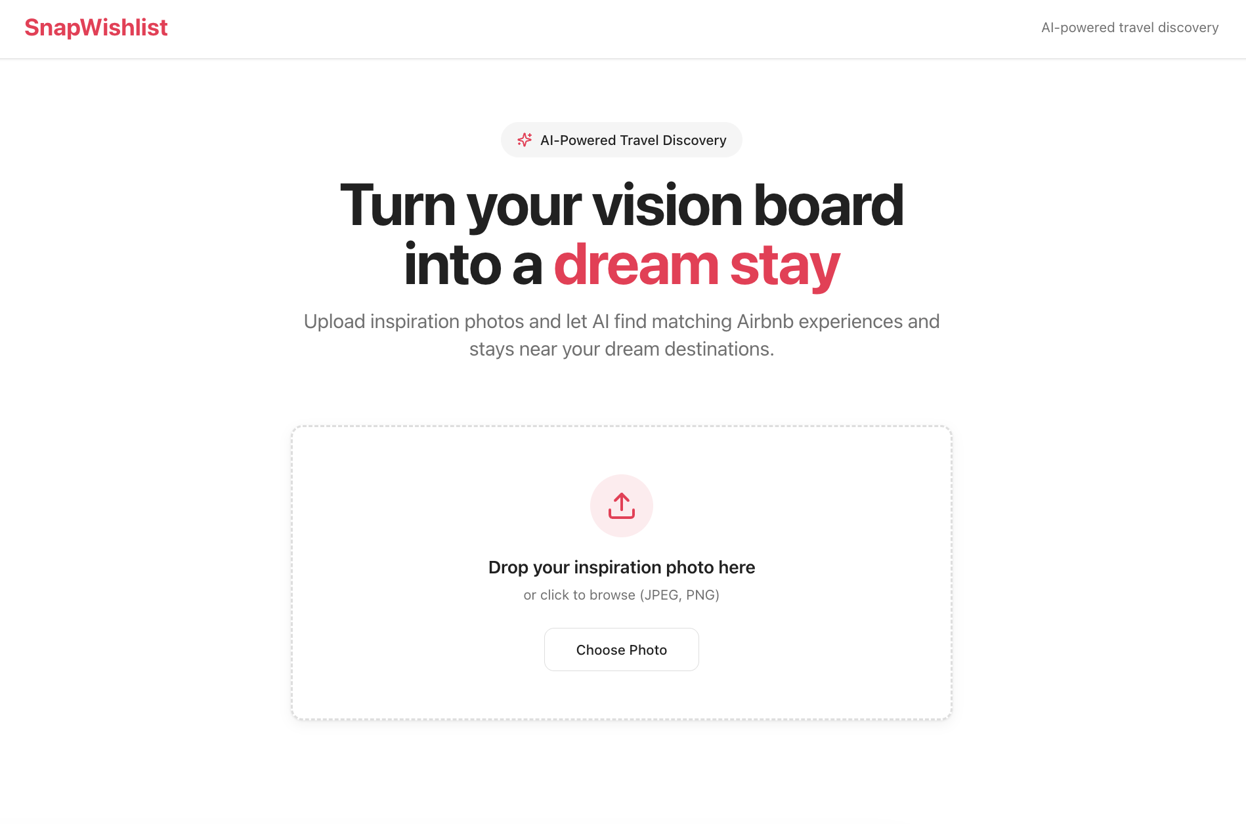
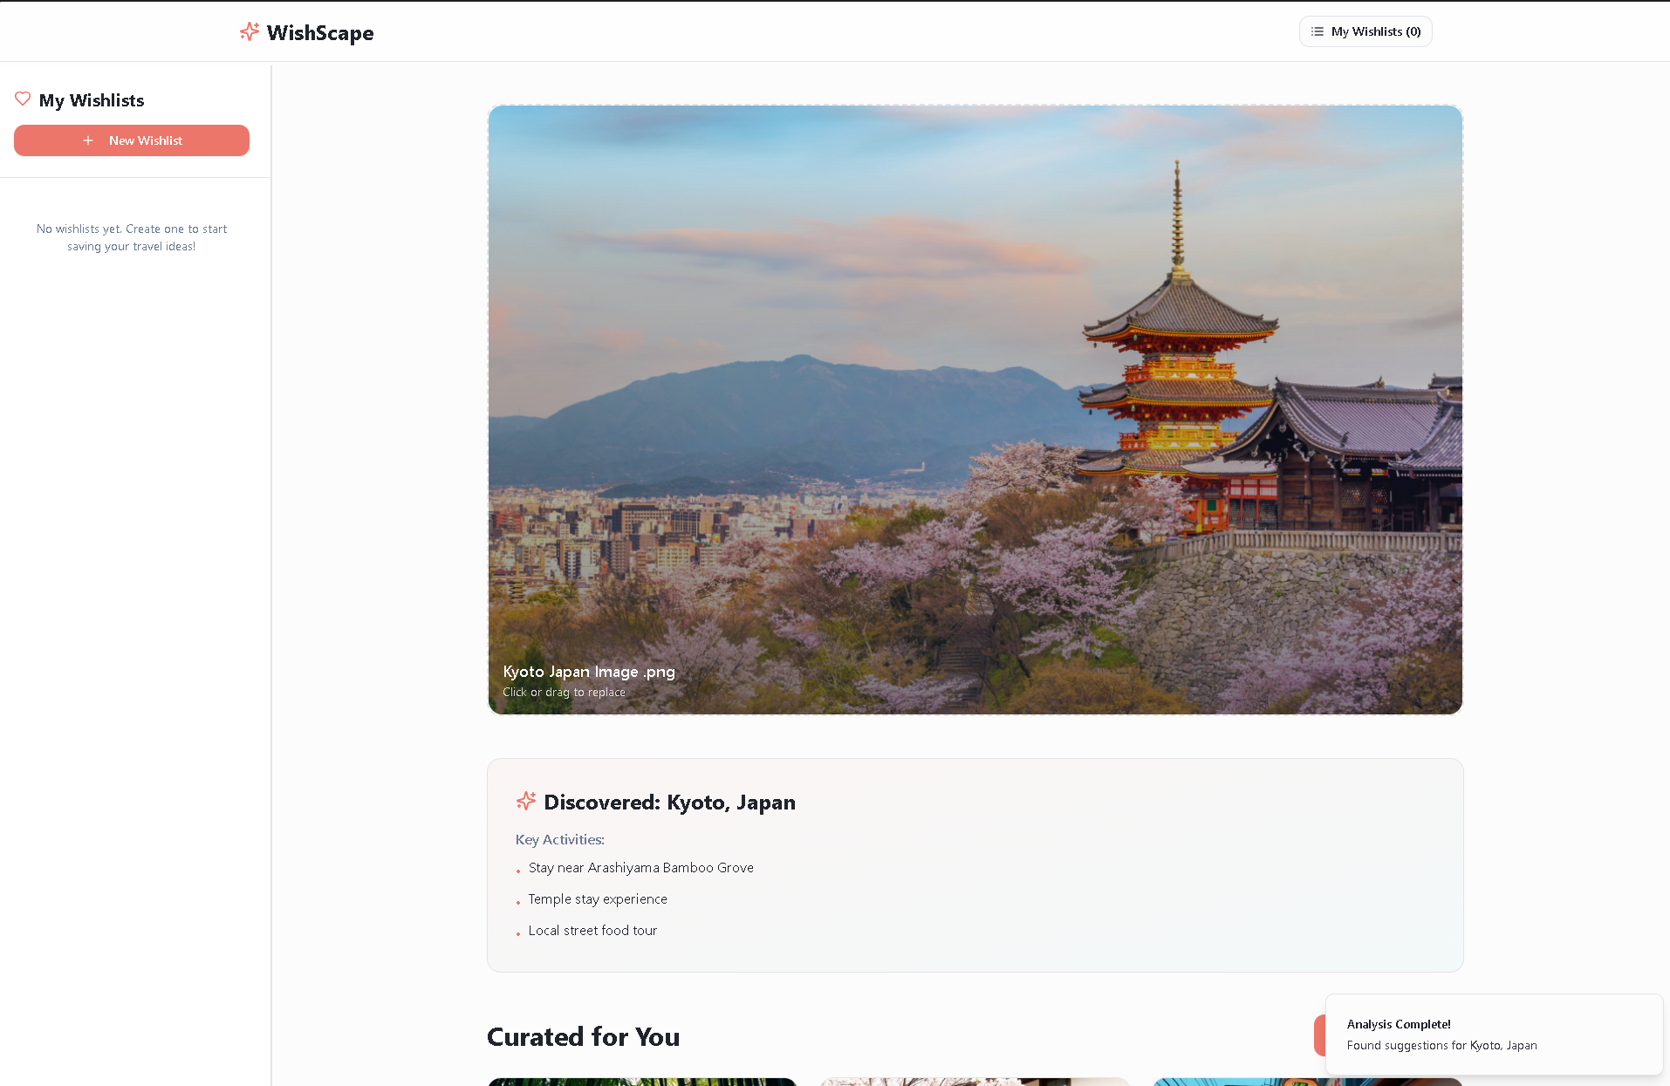
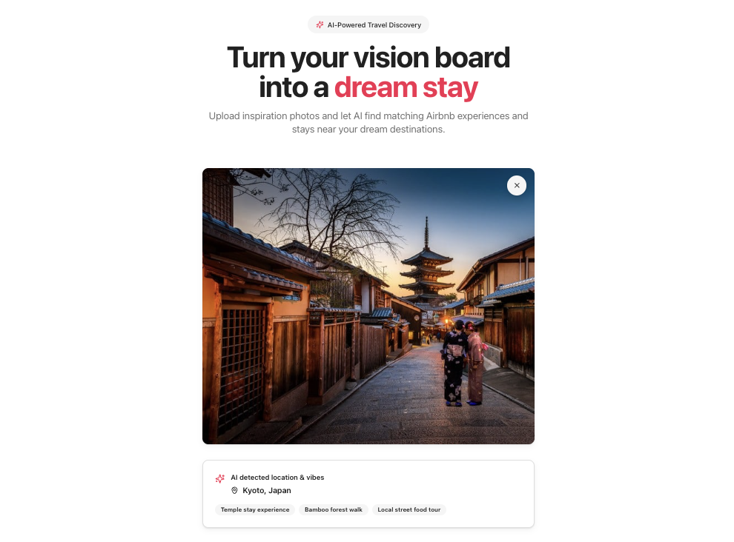
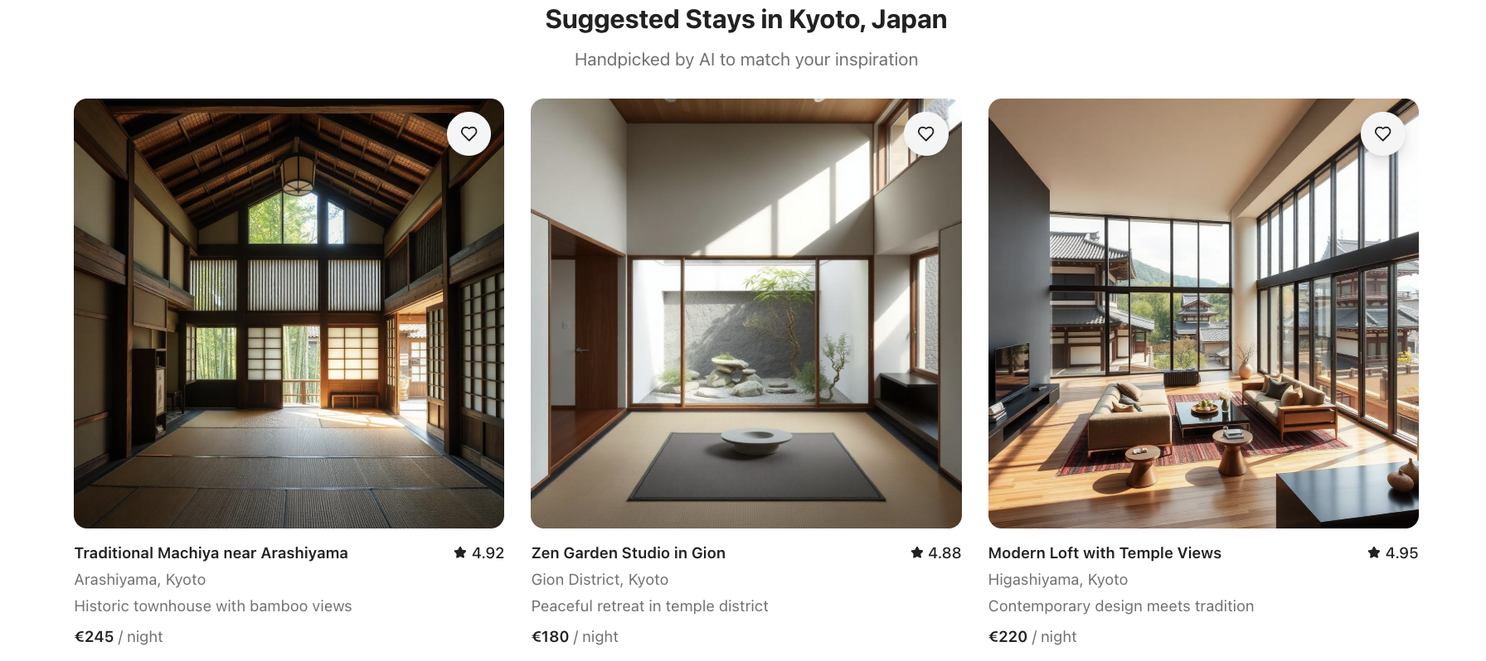
Instructor-Led Exercise
LAB EXERCISE OUTCOME
From Requirements to Prompt Pack
Notes:
Notes 📌 Note for Instructors: Briefly give a sneak peak of what students will be building, highlighting that this will be the final outcome of the exercise, and together with students you will walk through the steps together. Let them know its just one screen - the image just shows the different states of pre vs. post photo upload

Slide 19

Instructor-Led Exercise
Open 🔗 ChatGPT and paste the provided meta-prompt to convert the Snap Wishlist Simplified PRD into a consolidated 2-step prompt pack.
Open 🔗 Lovable and copy over your AI generated Prompt 1 (Setup & Upload) to run first.
Once generated, test the prototype. Then, copy over and run Prompt 2 (Logic & Results) to finalize your V1.
Identity missing FUDI elements from the example PRD (e.g., clicking the "Save" heart does nothing or cards cannot be clicked for details) and use your final credit to prompt the specific fix (either first with ChatGPT or directly in Lovable)
INSTRUCTIONS
20 minutes
From Requirements to Prompt Pack
In this hands-on lab, you will convert the Airbnb Snap Wishlist Simplified PRD into a strategic Prompt Pack to generate a working prototype using Lovable.
Your goal is is to master how to sequence static requirements into buildable prompts (Context → Structure → Logic) to create a high-fidelity prototype in minutes.
✍️ Complete the hands-on lab using the guide here
Notes:
Notes
💥Activity Type: Breakout Group Activity
✏️Task: From Requirements to Prompt Pack
⏱️Time: 20 minutes
Let’s put this PRO to the test and start building!
📌 Note for instructors: Instead of demoing yourself, ask a student volunteer to share their screen and follow the steps as you dictate while the class follows along. As they generate the pack, explicitly point out how the Meta-Prompt pulls text directly from the Simplified PRD sections, reinforcing the connection between the document and the code
We are using a strategy called "Bundling" to build the full app in just 2 prompts, conserving credits for the students. Walk through the first step (generating the Prompt Pack in ChatGPT) on your screen so they see the logic before they build.
Instructions:
👉 Ensure students follow along using the lab guide here
Open ChatGPT and paste the provided Meta-Prompt to generate the Prompt Pack — a consolidated list of two high-density prompts.
Review the output with students and highlight how Prompt 1 captures the Visuals/Setup and Prompt 2 captures the Logic/Data from the Simplified PRD example.
Instruct students to open Lovable and paste Prompt 1 to build the landing page and upload flow. Remind them to test the upload button (it may freeze- that’s ok, sine the logic isn’t built in yet).
Instruct students to paste Prompt 2 to inject the smart behaviors and mock JSON data. This reveals the results.
Finally, ask students to use their last credit to iterate: identify a missing gap (like the broken "Save" button) and prompt a specific fix (either in Lovable directly or using ChatGPT again).

Slide 20
Instructor-Led Q&A
Discuss the following questions
In the final step, you identified a gap (like the broken Save button). Why is it critical to go back and update your Simplified PRD with that fix, rather than just leaving it in the chat history?
Q&A DISCUSSION
5 minutes
Snap Wishlist Prototype Debrief
Feel free to post your answers in the chat or unmute and share!
To reflect on what you’ve just learned, share your perspective on the following:
Notes:
Notes
💥Activity: Instructor-Led Q&A
💬Topic: Snap WishList PRO to Prototype Debrief
⏱️Time: 5 Minutes
To reflect on what you’ve just learned, share your perspective on the following:
Questions:
In the final step, you identified a gap (like the broken Save button). Why is it critical to go back and update your Simplified PRD with that fix, rather than just leaving it in the chat history?
Key takeaway: If you don't update the Simplified PRD, your V2 will break. These requirements are your map; the prompt is just the vehicle. Don't lose the map.

Slide 21
Estimated time: 5 minutes
Notes:
Notes
Time for a 5-minute break—you’ve earned it! ☕

Slide 22





Reminder! 🚨
It's always better to see your smiling face! Be present and visible to stay engaged and keep interactions valuable.
Cameras On

Slide 23
AI Workflows For Requirements Refinement
Notes:
03. AI Workflows For Requirements Refinement

Slide 24
AI Workflows
Your “Co-PM” Playbook
Writing robust requirements from scratch is challenging.
AI can act as your "Co-PM" or sparring partner to accelerate this process at every step
USE IT TO:
Brainstorm and Ideate
01
Structure and Draft
02
Refine and Stress-Test
03
Notes:
Notes
You’ve seen how clear requirements can drive a prototype’s output. Now, let’s see how AI can help you build your Simplified PRD faster and smarter — acting like your sparring partner through every step.
Brainstorm and Ideate: Use AI to explore a range of directions for your idea and surface user needs you may not have considered. It helps you connect insights to problems worth solving and identify opportunities that align with your product vision.
Structure and Draft: Leverage AI to translate those ideas into a clear, organized PRD. It can help you outline each section, define key inputs and outputs, and maintain focus on what’s actionable — not just what’s possible.
Refine and Stress-Test: Treat AI as your co-PM for validation. Use it to challenge assumptions, pressure-test feasibility, and strengthen clarity across your PRD so what you hand off is both concise and resilient.

Slide 25
What Are You De-Risking?
A prototype is an experiment. Your hypothesis identifies the riskiest part of your Simplified PRD, which in turn tells you which AI “Co-PM" prompts are the most valuable for stress-testing.
If your risk is value:
If your risk is usability:
If your risk is feasibility:
First, ask: "What is the single riskiest assumption I need to validate?"
→ e.g., "Will users trust this AI's advice?" Focus on the 'Project Overview' and 'Smart Behaviors' sections and use the AI workflows to stress-test your value prop or brainstorm trustworthy alternatives.
→ e.g., "Will users get lost in this new AI-driven flow?" Focus on the 'Ideal User Flow' and 'Inputs/Outputs' sections and use the AI workflows to find missing edge cases or simplify the required user steps.
→ e.g., “"Can the AI actually generate a useful plan from these inputs?” Focus on the 'Core Tools/Stack' and ‘Constraints & Edge Cases’ sections and use the AI workflows to clarify technical requirements or define data handoffs.
Notes:
Notes
Keep in mind that every prototype is an experiment, and your job is to identify what part of it carries the most uncertainty. AI can help you zero in on that risk (whether it’s value, usability, or feasibility) and focus your refinement efforts there.
Ask yourself first, “What is the single riskiest assumption I need to validate?”
If your risk is Value: Use AI to question whether the product truly solves a problem users care about. Focus on the Project Overview and Smart Behaviors sections of your Simplified PRD. Prompt the AI to challenge your core logic: "Does this behavior actually solve the user's problem, or is it just a gimmick?" This helps you test the credibility and usefulness of your idea before you build.
If your risk is Usability: Ask AI to walk through your Ideal User Flow and Inputs & Outputs step by step. Use it to identify friction points where users might get confused about what to upload or where to click. This helps you find edge cases and unnecessary complexity before you prototype.
If your risk is Feasibility: Have AI stress-test the technical side by focusing on your Core Tools & Stack and Constraints. Use it to check if your chosen tech can actually handle the proposed logic. This lets you spot missing dependencies or unrealistic API expectations early, saving you from hitting a wall during the build.
By identifying which assumption carries the most uncertainty, you can use AI intentionally. This isn’t to fill out your Simplified PRD faster, but to strengthen its weakest point. This is how you move from a document that simply describes your product to one that actively de-risks it before a single line of code is written.

Slide 26
AI Workflows for Rapid
Simplified PRD Development
Project Overview
Use AI to generate a clear and concise product vision by summarizing the problem it solves and the desired outcome for the target audience.
"Act as a Senior PM. Draft a 1-sentence 'Job to be Done' and a clear Outcome for [Product Name] that targets [User Persona]."
Inputs and Outputs
Let AI define the key inputs and expected outputs based on the features and data flow, ensuring alignment with product goals and user needs.
"Create a data table for [Product Name] defining the exact Inputs (what the user provides) and Outputs (what the system returns). Focus on the data structure."
Ideal User Flow
"Outline a 'Happy Path' user flow for [Product Name] in exactly 5 steps, starting from [Entry Point] and ending at [Success State]."
Have AI map the ideal user journey, outlining the most important steps and interactions from start to finish, focusing on user success.
Notes:
Notes
These strategies can help you use AI tools to shape your Simplified PRD by clearly defining each section in a focused and actionable way. Here’s how to apply them:
Project Overview: AI can quickly help define your core intent, articulating the specific job the product does and who it does it for.
Example Prompt: “Act as a Senior PM. Draft a 1-sentence 'Job to be Done' and a clear Outcome for [Product Name] that targets [User Persona].”
This will give you a succinct, specific overview statement to anchor your prototype.
Inputs & Outputs: AI helps define the data contract, clarifying exactly what raw data enters the system and what visual results leave it.
Example: "Create a data table for [Product Name] defining the exact Inputs (what the user provides) and Outputs (what the system returns). Focus on the data structure."
This helps break down your data requirements clearly so the prototype isn't just a pretty picture.
User Flow: AI helps map out the user journey, ensuring a logical path from entry to success without getting lost in weeds.
Example: “Outline a 'Happy Path' user flow for [Product Name] in exactly 5 steps, starting from [Entry Point] and ending at [Success State].”
This will help ensure the user experience is smooth and the scope is manageable for a rapid prototype.

Slide 27
AI Workflows for Rapid
Simplified PRD Development
Smart Behaviors
"Define 3 'Smart Behaviors' for [Product Name] using strict 'If/Then' logic. How should the system adapt its output based on [User Input]?"
Use AI to define the "Brain" of the product, ensuring it responds dynamically to specific user actions rather than just displaying static data.
Core Tools and Stack
Use AI to identify the specific libraries or APIs needed to make the prototype functional, preventing scope creep by sticking to a lean, compatible stack.
"Recommend a lean tech stack for building a web prototype of [Product Name]. Focus on [Frontend Tool] + [AI Model] + [Data Source]."
Constraints and Edge Cases
"Identify 3 critical Constraints for [Product Name] to prevent hallucinations or broken UI. What happens if the user inputs [Bad Data]?"
Have AI predict failure modes—like bad inputs or API limits—so you can define guardrails that keep the prototype stable during demos.
Light Eval
Use AI to define a "Pass/Fail" test plan for the pilot and establish quantifiable targets for performance, accuracy, and user satisfaction to validate the prototype.
"Define success metrics for [Product Name] including specific targets for Latency (< X sec), Accuracy (%), and Usability (score /5)."
Notes:
Notes
Smart Behaviors: AI defines the logic behind product decisions, turning a static screen into an intelligent tool.
Example: “Define 3 'Smart Behaviors' for [Product Name] using strict 'If/Then' logic. How should the system adapt its output based on [User Input]?”
This helps you define the underlying rules (e.g., "If user selects X, filter by Y") so the prototype feels real.
Core Tools & Stack: AI suggests the specific technical ingredients needed to build the vision.
Example: “Recommend a lean tech stack for building a web prototype of [Product Name]. Focus on [Frontend Tool] + [AI Model] + [Data Source].”
This helps you ensure you aren't trying to use incompatible tools, keeping the build phase fast and feasible.
Constraints & Edge Cases: AI acts as a "Red Teamer," identifying where the product might break before you build it.
Example: “Identify 3 critical Constraints for [Product Name] to prevent hallucinations or broken UI. What happens if the user inputs [Bad Data]?”
This allows you to plan for "Unhappy Paths"—like what happens if a user uploads a blurry photo—so you can write the error handling logic into the Simplified PRD.
Light Eval: AI helps you define what "good" looks like, turning vague goals into specific numbers that tell you if the prototype succeeded.
Example: “Define success metrics for [Product Name] including specific targets for Latency (< X sec), Accuracy (%), and Usability (score /5).”
This gives you a clear checklist to know if your prototype is robust enough to graduate to a real product, rather than just relying on "it feels fast."

Slide 28
Breakout Group Exercise
Reminder: You're a Sr. PM in FlowFast's AI Prototyping Guild. The current fitness app has high churn because static plans don't adapt when users get tired or busy. In your groups, draft a Simplified PRD for your "AI Fitness Companion" prototype that simulates adaptive, daily planning to win executive buy-in.
Re-read the full context scenario in the first page of the template.
Collaboratively fill out the seven building blocks based on your team’s goals and requirements.
To ensure your prototype works (for Module 4), spend most of your time defining: Prioritize the "Core 4": To ensure your prototype works, spend the most time defining:
Project Overview (Goal & User)
Inputs & Outputs (The Data Contract)
Ideal User Flow (The Journey)
Smart Behaviors (The Logic)
Constraints & Edge Cases (The Risks)
Draft Your Fitness App Simplified PRD
INSTRUCTIONS
30 minutes
In this exercise, you’ll work in your assigned groups and apply your product thinking to create your Simplified PRD for your final project scenario.
Your goal is to use the AI workflows as a "co-PM" to help you brainstorm, structure, and draft the 7 building blocks.
Priority: Focus your energy on the core 5 that drive the prototype: Project Overview (Goal), Inputs & Outputs, Ideal User Flow, Smart Behaviors, Constraints
✍️ Complete the activity with the Simplified PRD Template here
Notes:
Notes
💥Activity: Breakout Group Exercise
✏️Task: Draft Your Fitness App Simplified PRD
⏱️Time: 30 Minutes
📌 Note for Instructors: The goal is for students to apply their product thinking to translate the final project course scenario into the 7 building blocks of the Simplified PRD. This is their first major artifact for the final project.
Remind students that whichever group they were in in Module 2 is the one they continue to return to when working on this exercise.
This artifact will be part of their deliverables for their final project, so when they finish, they can paste the link and details in the their final project deliverables template (slide 6)
Scenario: In this breakout group exercise, students will create their Simplified PRD for the AI Fitness Companion App scenario. Their goal is to translate the high-level problem (high churn, static plans) into a clear, actionable spec, focusing on the 7 building blocks.
Instructions:
👉 Make sure students use Simplified PRD Template to complete the exercise and share the project brief for quick access.
Ensure students have read the AI Fitness Companion App scenario on the slide, which provides the "why" for this project. Groups should review the detailed scenario description about what their final project deliverable is in the brief.
Then, in their designated groups, they should work collaboratively to fill out as many section of their Simplified PRD, using the template linked on the slide.
Let students know that if there are any sections they are unsure about, they can leave them blank and ask in the debrief session.
Remind students that this, like a traditional PRD, is a living document that will likely update as students learn more throughout this course.
➡️ Reminder to create Breakout Groups in Zoom

Slide 29
Instructor-Led Q&A
Discuss the following questions
What was the most challenging section of the Simplified PRD to define for your AI Fitness App (e.g., 'Smart Behaviors,' 'Light Eval')? Why was it difficult to scope?
Thinking about your own company's projects, which single section of the Simplified PRD do you think would be most valuable for getting faster, clearer buy-in from your stakeholders compared waiting and scoping a traditional PRD?
Q&A DISCUSSION
5 minutes
Prototyping Requirements Debrief
Feel free to post your answers in the chat or unmute and share!
You've just translated a high-level product concept into a concrete technical specification. This is the core skill of building valuable AI prototypes.
Notes:
Notes
💥Activity: Instructor-Led Q&A
💬Topic: Prototyping Requirements Debrief
⏱️Time: 5 Minutes
You've just translated a high-level product concept into a concrete technical specification. This is the core skill of building valuable AI prototypes. Discuss the following:
Questions:
What was the most challenging section of the Simplified PRD to define for the AI Fitness App (e.g., 'Smart Behaviors,' 'Light Eval')? Why was it difficult to scope?
Thinking about your own company's projects, which single section of the Simplified PRD do you think would be most valuable for getting faster, clearer buy-in from your stakeholders compared to a traditional PRD?

Slide 30
Key Takeaways
Define the Modern Specs for Prototype Development
Simplified PRDs are AI-first, concise specs that accelerate prototyping. They give clear, actionable instructions that speed up exploration and iteration compared with traditional documentation.
These requirements bridge ideas to prototypes and stakeholder alignment. Structured prompt packs help PMs move from concept to working outputs faster than lengthy PRDs.
Embed feasibility checks and success metrics directly into the requirement phase. PMs who define constraints and compliance needs upfront ensure their AI-generated prototypes are viable solutions that de-risk the product before engineering begins.
Notes:
Notes
At the end of each module, recap key concepts and content covered in today’s lesson.

Slide 31
Build, Iterate, and Debug Prototypes End-to-End
Extra Practice
Optional: Dig deeper into your hands-on lab experiences and try these exercises on your own.
1. Apply the Simplified PRD to Your Own Product or Company
Re-create your Simplified PRD using a different AI chatbot from what you used in the Lab (ChatGPT, Gemini, Claude, Perplexity, Deepseek, Grok, etc.) Compare the clarity and structure to your lab results.
2. Experiment with a PRD-focused AI Tool
Try to build your final project Simplified PRD using a tool like ChatPRD (signup required). Evaluate if results are better, worse, or similar.
⏩ Next Session
Overview
Translate requirements into a systematic workflow to build prototypes intelligently.
Debug and de-risk your builds with AI-first troubleshooting strategies.
Notes:
Notes
📌 Note: that the “Extra Practice” section is optional for students who want to get additional practice with more advanced topics or explore further on their own time.
Next Session: Give a brief overview of what students can expect during the next session.

Slide 32

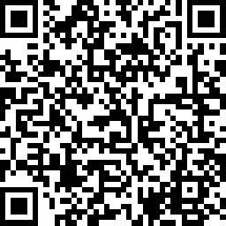
Share here
Your Opinion Matters To Us
We’d love to hear about your experience!
At the end of each session, please scan the QR code or use the link to share your feedback.
Your insights help us improve and make each cohort better than the last.
🔗 https://www.surveymonkey.com/r/MFRNZ3J
Notes:
Notes
We will be having daily surveys at the end of each class, and your opinion matters to us.
This is crucial in making sure our team can learn the best way to support you, and if we are also hitting the mark, Like real product managers, we would want to iterate and adjust so that we can support your needs.

Slide 33
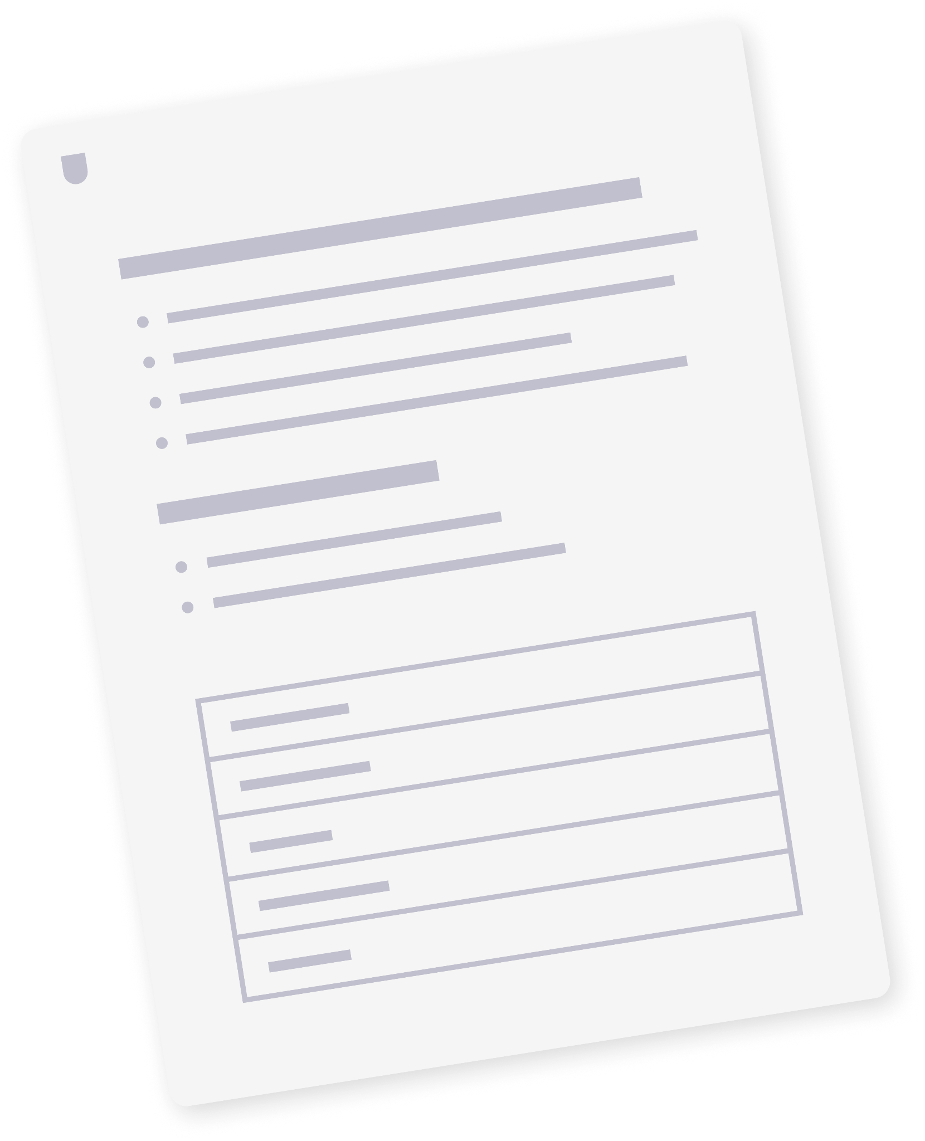
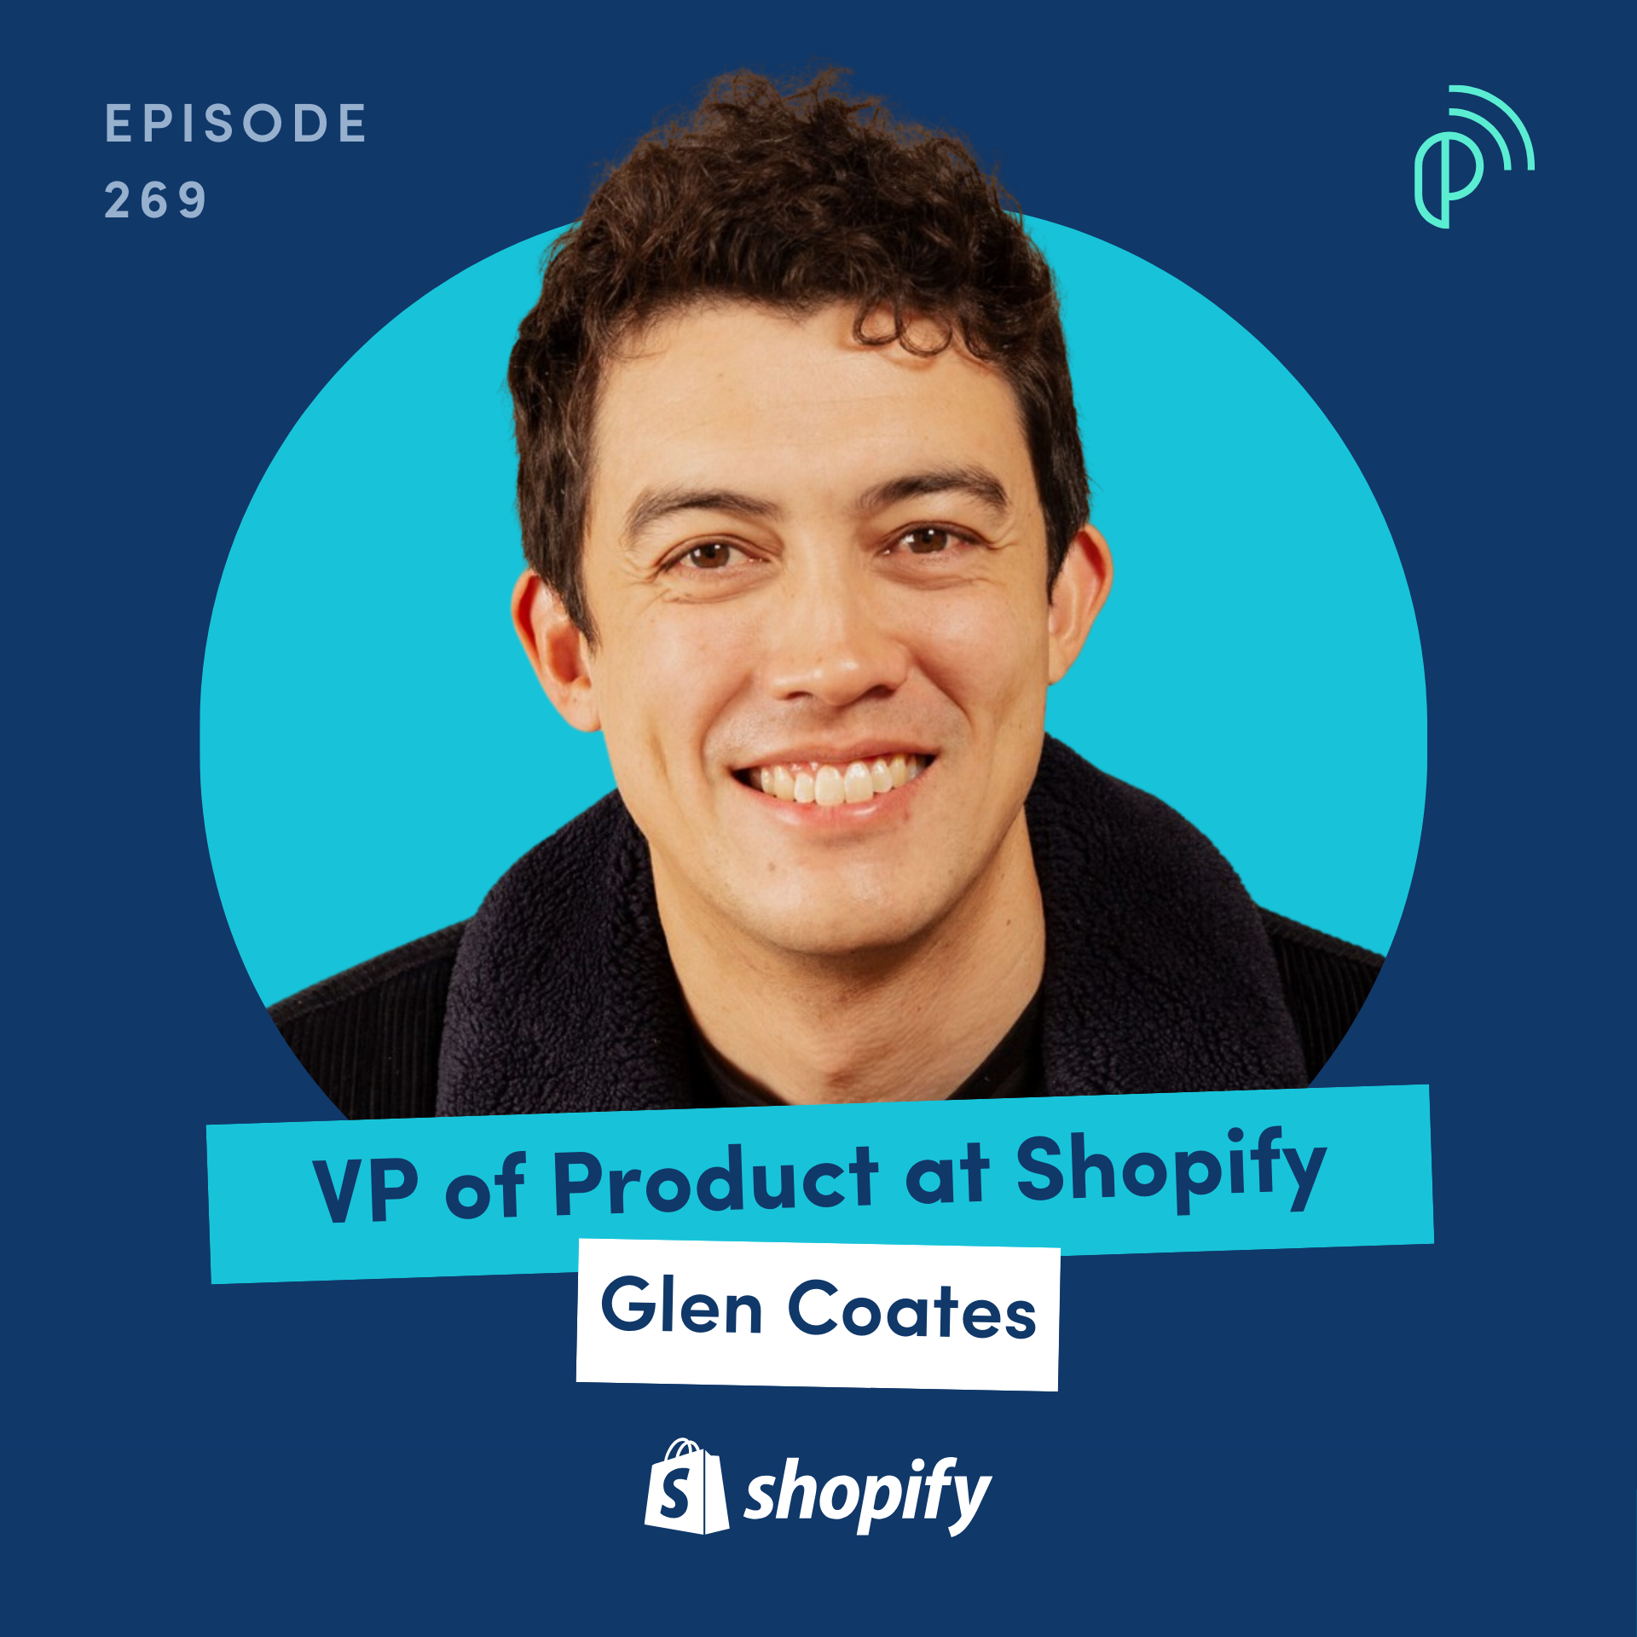

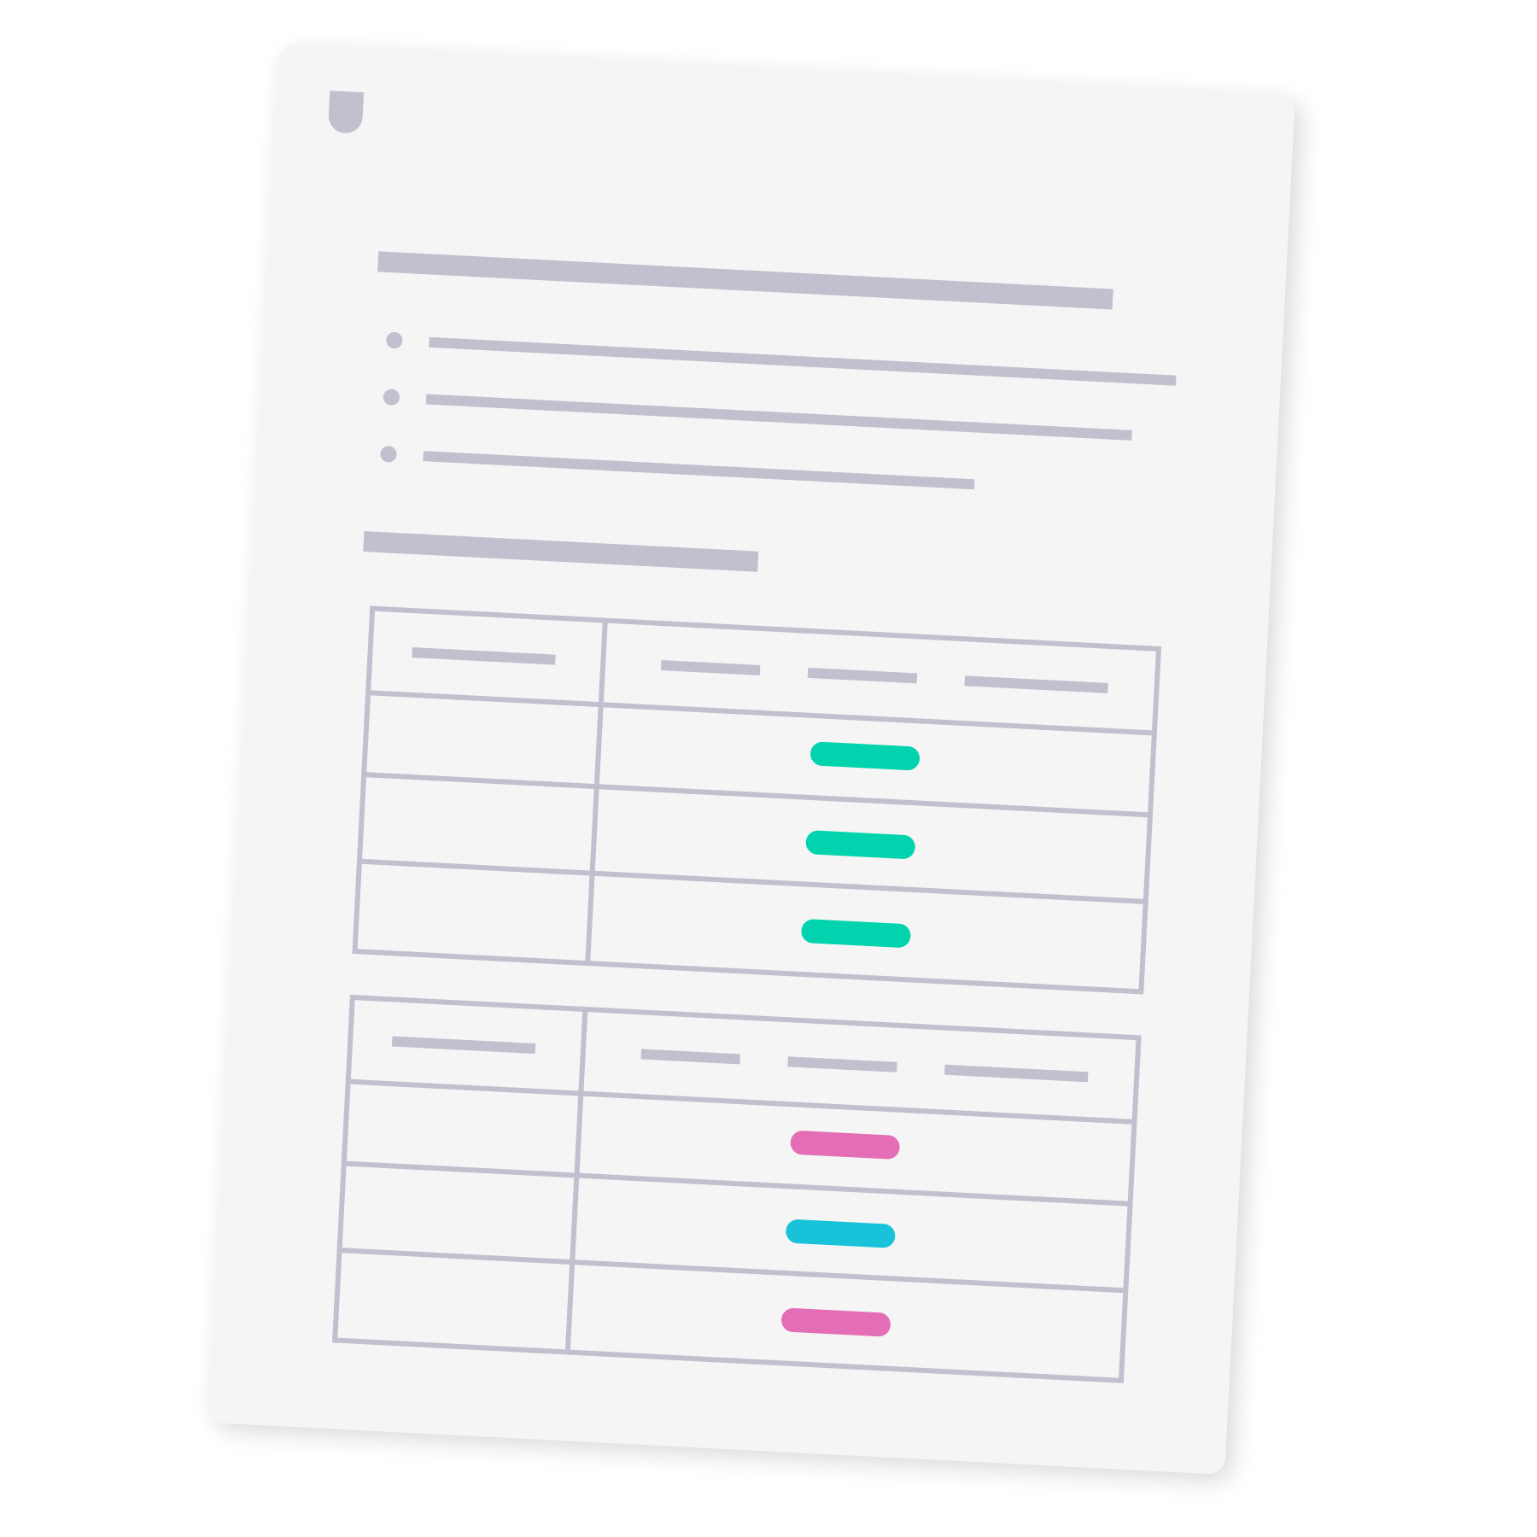
Resources & Templates
PRODUCT SCHOOL TEMPLATE
Simplified PRD for Prototypes
View template
HANDS-ON LAB GUIDE
THE PRODUCT PODCAST EPISODE
Module 3 Lab Guide
How to Build AI-First Products
View resource
View episode
Notes:
🗂 Resources
Here are resources students can leverage to deepen their knowledge of what we have covered in this class, as well as all materials used for activities.

Slide 34
Q&A
Notes:
Notes
💥Activity: Q&A
This is a chance to dive deeper into the topics covered and answer any additional questions students may have!

Slide 35
Notes:
Thank you 💥

